Slide 1
React.js
Course: CSC 436 Web Applications Instructor: Paul Duszak
Quarter: Fall 2022

Slide 2
What is React.js
Declarative, Component-based, Front-end UI framework
React was developed by Facebook, and is used in many large-scale web applications, such as Instagram, Facebook, and Netflix
We are going to learn how to build complex and efficient user interfaces with React
We are going to use a new React paradigm – Hooks in order to simplify state management and side effects

Slide 3
Principles of React (1/3)
Declarative – Instead of telling React how to do things, we tell it what we want it to do. This ensures React can efficiently update and render the minimum set of components necessary.
In the imperative example, we must tell the interpreter what to do step by step. In the declarative example we tell the interpreter concisely we want to map the input to str+str
Imperative code: Declarative code:
const input = ['a', 'b', 'c’]
let result = []
for (let i = 0; i < input.length; i++) {
result.push(input[i] + input[i])
}
console.log(result)
// prints: [ 'aa', 'bb', 'cc’ ]
const input = ['a', 'b', 'c']
let result = input.map(str => str + str)
console.log(result)
// prints: [ 'aa', 'bb', 'cc’ ]

Slide 4
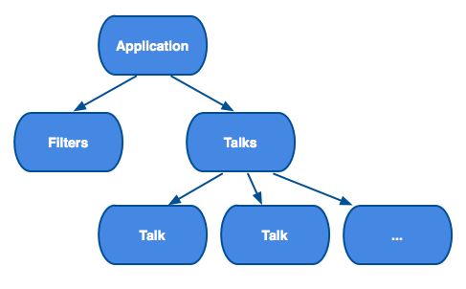
Principles of React (2/3)
Component-based – React encapsulates components that manage their own state and views and allow us to compose them in order to create complex user interface

Slide 5
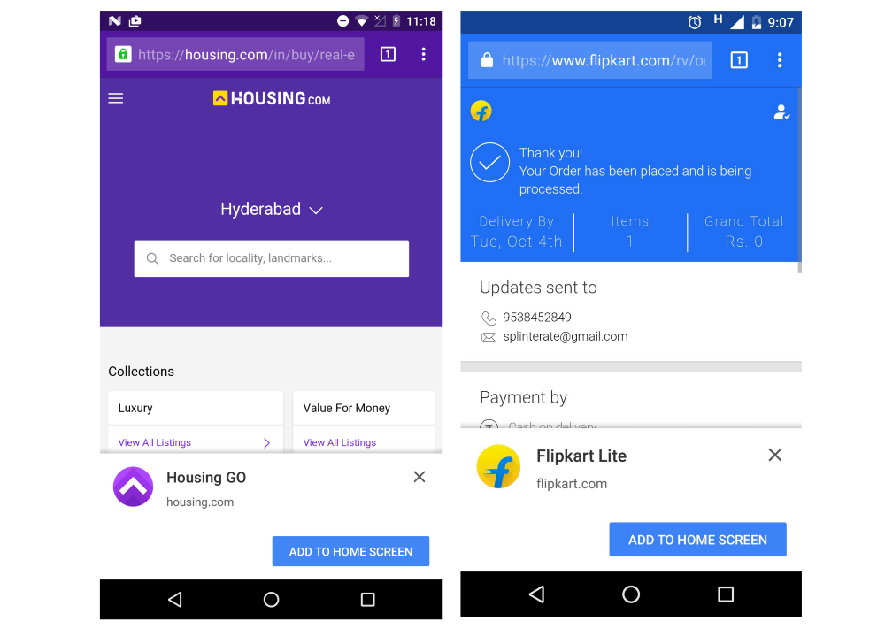
Principles of React (3/3)
Cross-platform – React does not make assumptions about the tech stack and apps can typically function cross platform with minimal code change
create-react-app supports building progressive web apps, which enables making web applications installable on mobile devices with a single codebase
No native mobile APIs

Slide 6
JSX (1/7)
const element = <h1>Hello, world!</h1>;
The above tag syntax is JSX, not HTML, nor a String.
JSX is a syntax extension to JavaScript, in React it is used to build the UI structure
JSX produces React elements which get rendered to the browser’s DOM.
React embraces the fact that rendering logic is inherently coupled with UI logic
Instead of separating UI and logic in separate files, React separates concerns with loosely coupled units called components which contain both

Slide 7
JSX (2/7) – Embedding Expressions
const name = 'Josh Perez';
const element = <h1>Hello, {name}</h1>;
ReactDOM.render(
element,
document.getElementById('root')
);
In the above example, we declare a variable called name and then use it inside JSX by wrapping it in curly braces
You can put any valid JavaScript expression inside the curly braces in JSX. For example, 2 + 2, user.firstName, or formatName(user) are all valid JavaScript expressions.

Slide 8
JSX (3/7) – Embedding Expressions
function formatName(user) {
return user.firstName + ' ' + user.lastName;
}
const user = {
firstName: 'Harper',
lastName: 'Perez'
};
const element = (
<h1>
Hello, {formatName(user)}!
</h1>
);
ReactDOM.render(
element,
document.getElementById('root')
);
In this example, we embed the result of calling a JavaScript function formatName(user) into an <h1> element
The JSX is split over multiple lines for readability, while not required, it is recommended to wrap multi-line JSX in parens

Slide 9
JSX (4/7) – JSX – Adding Attributes
const element = <div tabIndex="0"></div>; const element = <img src={user.avatarUrl}></img>;
You may have noticed JSX looks similar to HTML markup
HTML markup allows you to add attributes to elements, as does JSX
You can use quotes to specify string literals as attributes, similar to HTML
However, you can also use curly braces to embed a JavaScript expression as an attribute (no need for quotes)
Warning:
Since JSX is closer to JavaScript than to HTML, React DOM uses camelCase property naming convention instead of HTML attribute names.
For example, class becomes className in JSX, and tabindex becomes tabIndex.

Slide 10
JSX(5/7) – JSX is also an Expression
function getGreeting(user) {
if (user) {
return <h1>Hello, {formatName(user)}!</h1>;
}
return <h1>Hello, Stranger.</h1>;
}
After compilation, JSX expressions become regular JavaScript function calls and evaluate to JavaScript objects.
As a result, you can use JSX inside of if statements and for loops, assign it to variables, accept it as arguments, and return it from functions

Slide 11
JSX(6/7) – Children
const element = (
<div>
<h1>Hello!</h1>
<h2>Good to see you here.</h2>
</div>
);
If a tag is empty, you may close it immediately with />, like XML
JSX tags may contain children

Slide 12
JSX(7/7) – What is JSX translated to?
const element = (
<h1 className="greeting">
Hello, world!
</h1>
);
Babel compiles JSX down to React.createElement() calls
React.createElement() performs a few checks to help you write bug-free code but essentially it creates an object
These objects are called “React elements”. You can think of them as descriptions of what you want to see on the screen. React reads these objects and uses them to construct the DOM and keep it up to date.
const element = React.createElement(
'h1',
{className: 'greeting'},
'Hello, world!'
);
// Note: this structure is simplified
const element = {
type: 'h1',
props: {
className: 'greeting',
children: 'Hello, world!'
}
};

Slide 13
React Elements(1/4)
Unlike browser DOM elements, React elements are plain objects, immutable, and are cheap to create. React DOM takes care of updating the DOM to match the React elements.
React uses a “virtual” DOM – React maintains an in-memory representation of the browser’s DOM. As elements update, React updates it’s virtual DOM and performs a diff against the browser’s DOM and updates only the changed nodes

Slide 14
React Elements (2/4)
const element = <h1>Hello, world!</h1>;
React elements are the smallest building block of React applications
React elements are plain objects, and are cheap to create. React DOM takes care of updating the DOM to match the React elements
React elements are different than React components; components are composed of elements

Slide 15
React Elements (3/4) – Rendering to DOM
HTML:
<div id="root"></div>
React JavaScript:
const myReactElement = <h1>Hello, world</h1>;
ReactDOM.render(myReactElement, document.getElementById('root'));
React applications typically have one root DOM node
In the above HTML the HTML div element with ID of “root” will act as our React ‘root’ DOM node and everything inside of it will be managed by React
Passing myReactElement to ReactDOM.render() and specifying the HTML root element will have the effect of rendering “Hello, world” on the HTML page

Slide 16
React Elements (4/4) – Updating rendered elements
function tick() {
const element = (
<div>
<h1>Hello, world!</h1>
<h2>It is {new Date().toLocaleTimeString()}.</h2>
</div>
);
ReactDOM.render(element, document.getElementById('root'));
}
setInterval(tick, 1000);
The above example calls ReactDOM.render() once every second using the setInterval() callback
In practice, most React apps only call ReactDOM.render() once. We will review how such code gets encapsulated into stateful components.

Slide 17
DOM(1/2) - What is the DOM?
The Document Object Model (DOM) is the data representation (a tree) of the objects that comprise the structure and content of a document on the web
A web page is a document that can be either displayed in the browser window or as the HTML source. In both cases, it is the same document but the Document Object Model (DOM) representation allows it to be manipulated
DOM Problems:
DOM trees are huge. Modern, dynamic web apps need to update the DOM frequently
Consider a DOM with 1000s of DIV elements:
It becomes very hard to manage (jQuery requires creation of event handlers which target particular nodes in the DOM, requires tree traversals and intimate knowledge of element structure
Updating the DOM becomes inefficient and slow (renders potentially re-rendering the entire DOM)

Slide 18
DOM(2/2) – React’s approach to the DOM
Unlike browser DOM elements, React elements are plain objects, immutable, and are cheap to create. React DOM takes care of updating the DOM to match the React elements.
React uses a “virtual” DOM – React maintains an in-memory representation of the browser’s DOM. As elements update, React updates it’s virtual DOM and performs a diff against the browser’s DOM and updates only the changed nodes

Slide 19
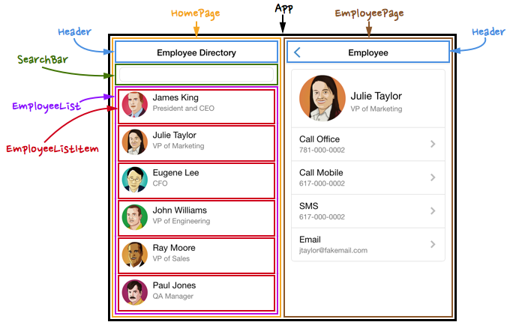
Components and Props
Components let you split the UI into independent, reusable pieces, and think about each piece in isolation.
Conceptually, components are like JavaScript functions. They accept arbitrary inputs (called “props”) and return React elements describing what should appear on the screen.

Slide 20
Class Components vs Function components
Class components: JavaScript classes that provide a render method, which returns the user interface (via JSX)
Function components: JavaScript functions that take the props as an argument, and return the user interface (via JSX)
We will utilize React’s Hooks API(s) and function components as opposed to class components

Slide 21
Issues with Class components
Many existing React applications are built using class components
When utilizing class-based components, we are often forced to define multiple life cycle methods, for example, if we fetch data when a component renders, we have to use define two life-cycle methods, componentDidMount and componentDidUpdate
State management is more complex when utilizing class components because it requires we make calls to the this.setState method. This creates complexity as the this keyword in Javascript behaves differently based on the current context, which requires us to manually bind this in each component

Slide 22
Class Components vs Function components
Class component fetching data on render:
Function component fetching data on render:
class Example extends React.Component { ...
componentDidMount () {
this.fetchData()
}
componentDidUpdate (prevProps) {
if (this.props.name !== prevProps.name) {
this.fetchData()
} } fetchData () {
fetch(`http://my.api/${this.props.name}`)
.then(...)
}
}
function Example ({ name }) {
... useEffect(() => {
fetch(`http://my.api/${this.props.name}`)
.then(...)
}, [ name ])
}
The Effect Hook that was implemented here will automatically trigger when the component mounts, and whenever the name prop changes.
Since the Effect Hook is just a method, useEffect, our component does not need to be a class which inherits React.Component in order to access lifecycle methods or manage state.
Using a class component, we must define the componentDidMount lifecycle method for when the component initially renders, but we also must define the componentDidUpdate lifecycle method in case the name prop changes. Redundancy can lead to bugs.

Slide 23
Rendering a Component (1/2)
React element that represent DOM tag:
const element = <div />;
React element that represent user-defined component:
const element = <Welcome name="Sara" />;
React Elements can represent HTML tags or user-defined components
When React sees an element representing a user-defined component, it passes JSX attributes and children to this component as a single object. We call this object “props

Slide 24
Rendering a Component (2/2)
function Welcome(props) {
return <h1>Hello, {props.name}</h1>;
}
const element = <Welcome name="Sara" />;
ReactDOM.render(
element,
document.getElementById('root')
);
1. We call ReactDOM.render() with the <Welcome name="Sara" /> element.
2. React calls the Welcome component with {name: 'Sara'} as the props.
3. Our Welcome component returns a <h1>Hello, Sara</h1> element as the result.
4. React DOM efficiently updates the DOM to match <h1>Hello, Sara</h1>.
Note: Always start component names with a capital letter.
React treats components starting with lowercase letters as DOM tags. For example, <div /> represents an HTML div tag, but <Welcome /> represents a component and requires Welcome to be in scope.

Slide 25
Rendering Multiple Components
function Welcome(props) {
return <h1>Hello, {props.name}</h1>;
}
function App() {
return (
<div>
<Welcome name="Sara" />
<Welcome name="Cahal" />
<Welcome name="Edite" />
</div>
);
}
ReactDOM.render(
<App />,
document.getElementById('root')
);
Components can refer to other components in their output. This lets us use the same component abstraction for any level of detail. A button, a form, a dialog, a screen: in React apps, all those are commonly expressed as components
Typically React components will have a single root element, in this example the “App” component which gets rendered in the HTML element with ID “root”

Slide 26
Component Abstraction (1/2)
function Comment(props) {
return (
<div className="Comment">
<div className="UserInfo">
<img className="Avatar"
src={props.author.avatarUrl}
alt={props.author.name}
/>
<div className="UserInfo-name">
{props.author.name}
</div>
</div>
<div className="Comment-text">
{props.text}
</div>
<div className="Comment-date">
{formatDate(props.date)}
</div>
</div>
);
}
Don’t hesitate to split components into smaller components
Consider the Comment component on the left ; it accepts an author (object), text (string), and date (Date) – updating this component can be difficult due to the level of nesting

Slide 27
Component Abstraction (2/2)
The previous Comment component example can be split into 3 components in order to simplify each and increase re-usability
function Avatar(props) {
return (
<img className="Avatar"
src={props.user.avatarUrl}
alt={props.user.name}
/>
);
}
function Comment(props) {
return (
<div className="Comment">
<UserInfo user={props.author} />
<div className="Comment-text">
{props.text}
</div>
<div className="Comment-date">
{formatDate(props.date)}
</div>
</div>
);
}
function UserInfo(props) {
return (
<div className="UserInfo">
<Avatar user={props.user} />
<div className="UserInfo-name">
{props.user.name}
</div>
</div>
);
}
The Avatar and UserInfo components can be used within the Comment component or anywhere else in the application
If you need to use a particular UI piece in multiple places, it is a good candidate to extract to a separate component

Slide 28
React Hooks
A Hook is a special function that lets you “hook into” React features. For example, the useState is a Hook that lets you add React state to function components
What Hooks exist?
useState - Returns a stateful value, and a function to update it
useEffect - Accepts a function that contains imperative, possibly effectful code
useContext - Accepts a context object (returned from React.createContext) and returns the current context value for that context.
useReducer - An alternative to useState. Accepts a reducer of type (state, action) => newState, and returns the current state paired with a dispatch method.
useMemo - Returns a memorized value

Slide 29
Using create-react-app (1/2)
To initialize a React project, we can use the create-react-app tool, which sets up the environment for React development, including the following:
Babel, so that we can use the JSX and ES6 syntaxes
Additionally, we could even use TypeScript and Flow syntax
A live development server, which warns us about common mistakes
A build script, which bundles JavaScript, CSS, and images for production, including hashes and sourcemaps
An offline-first service worker and a web app manifest to meet all criteria of a Progressive Web App (PWA)
Hassle-free updates for all the tools that have been previously listed

Slide 30
Using create-react-app (2/2)
create-react-app can be installed as a global npm package, allowing us to execute it from the cmd/terminal
Installing create-react-app:
npm install -g create-react-app
(no longer suggested after create-react-app v5.0.1, use npx instead: npx create-react-app my-app)
Creating a new React project:
create-react-app <react-app-name>
Starting a React project (executed from within project directory):
npm run start

Slide 31
useState Hook
We will use the useState hook to add and manage state within a component. Let’s look at an example of a function component that contains a text input prompting a user to enter the name; the name will then be used in a greeting.
Reference: https://reactjs.org/docs/hooks-state.html
import {useState} from ’react’
function App() {
const [name, setName] = useState(‘’)
function handleNameChange(evt) { setName(evt.target.value)
} return ( <div> <h1>Hello {name}</h1>
<input type=“text” value={name} onChange={handleNameChange} /> </div> ) }
export default App

Slide 32
App as a Class Component
Below is an example of the App component on the previous slide if it were to be written as a class component instead of a function component.
import React from ‘react’
class App extends React.Component {
constructor (props) {
super(props)
this.state = { name: '' }
this.handleChange = this.handleChange.bind(this)
}
handleChange (evt) {
this.setState({ name: evt.target.value })
}
render () {
const { name } = this.state
return (
<div>
<h1>My name is: {name}</h1>
<input type="text" value={name} onChange={this.handleChange} />
</div>
)
}
}
export default App
import {useState} from ’react’
function App() {
const [name, setName] = useState(‘’)
function handleNameChange(evt) { setName(evt.target.value)
} return ( <div> <h1>Hello {name}</h1>
<input type=“text” value={name} onChange={handleNameChange} /> </div> ) }
export default App

Slide 33
Building a Blog
Goals:
See how to structure React apps in a way that scales well
See how to use multiple Hooks
See where to store state
See how to solve common use cases with Hooks
Build a basic blog application, where we can log in, register, and create posts

Slide 34
React App Structure
Expected functionality:
Registering users
Logging in/out
Viewing a single post
Creating a new post
Listing posts
Feature groups:
User (registering, log in/out
Post (creating, viewing, lists
Initial Structure:
src/
src/user/
src/post/

Slide 35
Component Structure
Ideally, each component deals with a single task or UI element
Try to make components as fine-grained as possible, in order to be able to reuse code
If copying and pasting code from one component to another, it might be a good idea to create a new component, and reuse it in multiple other components

Slide 36
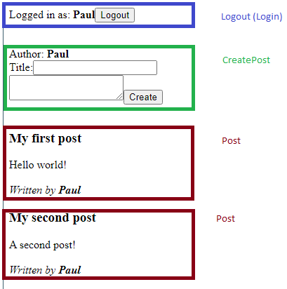
Blog Mockup
When splitting components, we use the single responsibility principle, which states that every module should have responsibility over a single encapsulated part of the functionality

Slide 37
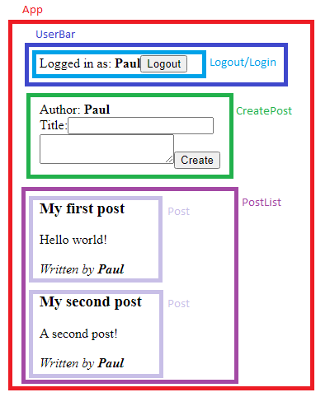
Blog Mockup
Now that we have defined our fundamental components, we are going to look at which components logically belong together, thereby forming a group. To do so, we now define the container components, which we need in order to group the components together

Slide 38
Implementing Static Components
Before adding Hooks to our application, we will model the basic features as static React components

Slide 39
Initializing our project
Execute:
npx create-react-app <project-name> to init a new project

Slide 40
Implementing user functionality
Components:
Login - Displays when a user is not logged in, enable login
Register - Displays when a user is not logged in, enable registration
Logout - Display when a user is not logged in
UserBar - Contains the above components and determines which to display

Slide 41
src/Login.js
The Login component will be responsible for rendering username and password fields, with labels. It will also render a login button to process the form submission.
export default function Login() {
return (
<form onSubmit={e => e.preventDefault()}>
<label htmlFor="login-username">Username:</label>
<input type="text" name="login-username" id="login-username" />
<label htmlFor="login-password">Password:</label>
<input type="password" name="login-password" id="login-password" />
<input type="submit" value="Login" />
</form>
)
}

Slide 42
src/Logout.js
The Logout component will display the currently logged in user’s username, as well as a submit button to process the form submission
export default function Logout({user}) {
return (
<form onSubmit={e => e.preventDefault()}>
Logged in as: <b>{user}</b>
<input type="submit" value="Logout" />
</form>
)
}

Slide 43
src/Register.js
The register component will display inputs for username, password, and password repeat, as well a register button to process the form submission.
export default function Register() {
return (
<form onSubmit={e => e.preventDefault()}>
<label htmlFor="register-username">Username:</label>
<input type="text" name="register-username" id="register-username" />
<label htmlFor="register-password">Password:</label>
<input type="password" name="register-password" id="register-password" />
<label htmlFor="register-password-repeat">Repeat password:</label>
<input type="password" name="register-password-repeat" id="register-password-repeat" />
<input type="submit" value="Register" />
</form>
)
}

Slide 44
src/UserBar.js
The UserBar component will conditionally render the Login, Logout, and Register components.
import Login from './Login'
import Logout from './Logout'
import Register from './Register'
export default function UserBar() {
const user = ''
if (user) { return <Logout user={user} /> } else {
return (
<>
<Login />
<Register />
</>
)
} }

Slide 45
Implementing post functionality
Components:
Post - Displays a single post
CreatePost - Displays a form for creating new posts
PostList - Displays multiple posts

Slide 46
src/Post.js
The Post component is responsible for rendering a post’s title, content, and author.
export default function Post ({ title, content, author }) {
return (
<div>
<h3>{title}</h3>
<div>{content}</div>
<br />
<i>Written by <b>{author}</b></i>
</div> )
}

Slide 47
src/CreatePost.js
The CreatePost component renders a form accepting a title and content for a new post
export default function CreatePost ({user}) {
return (
<form onSubmit={e => e.preventDefault()}>
<div>Author: <b>{user}</b></div>
<div>
<label htmlFor="create-title">Title:</label>
<input type="text" name="create-title" id="create-title" />
</div>
<textarea />
<input type="submit" value="Create" />
</form> )
}

Slide 48
src/PostList.js
The PostList component is responsible for rendering a list of Post components.
import Post from ‘./Post’
export default function PostList ({posts = []}) {
return (
<div>
{posts.map((p, i) => <Post {...p} key={'post-' + i} />)}
</div> )
}

Slide 49
Making Components Stateful
We have implemented static structure of our application
Next, we will make use of the useState hook in order to be able to store state and handle dynamic interactions

Slide 50
Adding state to the UserBar component
import { useState } from 'react’
import Login from './Login'
import Logout from './Logout'
import Register from './Register'
export default function UserBar() {
const user = ‘’
const [ user, setUser ] = useState(‘’)
if (user) {
return <Logout user={user} setUser={setUser} />
} else {
return (
<>
<Login setUser={setUser} />
<Register setUser={setUser} />
</>
)
} }
Now, the UserBar component provides a setUser function, which can be used in the Login, Register, and Logout components to set or unset the user value.

Slide 51
Adding state to the Login component
import React, { useState } from ‘react’
export default function Login({ setUser }) {
const [ username, setUsername ] = useState(‘’)
function handleUsername (evt) { setUsername(evt.target.value) }
return (
<form onSubmit={e => { e.preventDefault(); setUser(username); }}>
<label htmlFor="login-username">Username:</label>
<input type="text“ value={username} onChange={handleUsername} name="login-username" id="login-username" />
<label htmlFor="login-password">Password:</label>
<input type="password" name="login-password" id="login-password" />
<input type="submit" value="Login“ disabled={username.length === 0} />
</form>
)
}
In HTML, form elements such as <input>, <textarea>, and <select> typically maintain their own state and update it based on user input. In React, mutable state is typically kept in the state property of components, and only updated with useState()/ setState().
We can combine the two by making the React state be the “single source of truth”. Then the React component that renders a form also controls what happens in that form on subsequent user input. An input form element whose value is controlled by React in this way is called a “controlled component”.

Slide 52
Adding state to the Register component
import { useState } from 'react'
export default function Register({ setUser }) {
const [ username, setUsername ] = useState(‘’)
const [ password, setPassword ] = useState('')
const [ passwordRepeat, setPasswordRepeat ] = useState('')
function handleUsername (evt) { setUsername(evt.target.value) }
function handlePassword (evt) { setPassword(evt.target.value) }
function handlePasswordRepeat (evt) { setPasswordRepeat(evt.target.value) }
return (
<form onSubmit={e => { e.preventDefault(); setUser(username) }}>
<label htmlFor="register-username">Username:</label>
<input type="text“ value={username} onChange={handleUsername} name="register-username" id="register-username" />
<label htmlFor="register-password“>Password:</label>
<input type="password" name="register-password" id="register-password“value={password} onChange={handlePassword} />
<label htmlFor="register-password-repeat>Repeat password:</label>
<input type="password" name="register-password-repeat" id="register-password-repeat““ value={passwordRepeat} onChange={handlePasswordRepeat} />
<input type="submit" value="Register“ disabled={username.length === 0 || password.length === 0 || password !== passwordRepeat} />
</form>
)
}

Slide 53
Adding state to the Logout component
export default function Logout({user, setUser}) {
return (
<form onSubmit={e => { e.preventDefault(); setUser(‘’)} }>
Logged in as: <b>{user}</b>
<input type="submit" value="Logout" />
</form>
)
}

Slide 54
How do we pass user info to CreatePost?
User state in our app is currently maintained in the UserBar; however, CreatePost also needs User info.
User state is global state, so we need to move the User hook out of UserBar and into App. Later we will use Context Hooks to manage global state
1. Edit src/user/UserBar.js, and cut/remove the Hook definition that is there:
const [ user, setUser ] = useState(‘’)
2. Then, we edit the function definition, and accept these two values as props:
export default function UserBar ({ user, setUser }) {
3. Now, we edit src/App.js, and import the useState Hook there:
import { useState } from 'react’
4. Next, we remove the static user value definition:
const user = ‘Paul’
5. Then, we insert the user State Hook that we cut earlier into the App component function:
const [ user, setUser ] = useState(‘’)
6. Now, we can pass user and setUser as props to the UserBar component:
<UserBar user={user} setUser={setUser} />
7. Lastly, we can update the CreatePost component to only be shown to logged in user by doing the following:
{user && <CreatePost user={user} />}

Slide 55
Adding state to the Post component
Similar to user information, posts are global state as the PostLIst and CreatePost components need to access it
1. In App.js rename the posts list to intialPosts
2. In App.js, define a new State Hook for the posts state:
const [ posts, setPosts ] = useState(initialPosts)
3. Now, we pass the posts value and setPosts function as props to the CreatePost component:
{user && <CreatePost user={user} posts={posts} setPosts={setPosts} />}

Slide 56
Update CreatePost to update Posts
Similar to user information, posts are global state as
1. In CreatePost.js accept the posts and setPosts props
2. Define two new State Hooks to manage the title and content text inputs:
const [ title, setTitle ] = useState(‘’)
const [ content, setContent ] = useState(‘’)
3. Create three handler functions for the title input, content textarea, and submit button:
function handleTitle (evt) { setTitle(evt.target.value) }
function handleContent (evt) { setContent(evt.target.value) }
function handleCreate () { const newPost = { title, content, author: user }
setPosts([ newPost, ...posts ])
}
4. Update all three inputs to use three handlers:
<input type="text" value={title} onChange={handleTitle} name="create-title" id="create-title" /> <textarea value={content} onChange={handleContent} /> <form onSubmit={e => n}}>

Slide 57
Simplifying Register using an object
import React, { useState } from 'react'
export default function Register({ setUser }) {
const [ formData, setFormData ] = useState({
username: "",
password: "",
passwordRepeat: ""
})
return (
<form onSubmit={e => { e.preventDefault(); setUser(formData.username) }}>
<label htmlFor="register-username">Username:</label>
<input type="text" value={formData.username} onChange={e => setFormData({...formData, username: e.target.value})} name="register-username" id="register-username" />
<label htmlFor="register-password">Password:</label>
<input type="password" name="register-password" id="register-password“ value={formData.password} onChange={e => setFormData({...formData, password: e.target.value})} />
<label htmlFor="register-password-repeat">Repeat password:</label>
<input type="password" name="register-password-repeat" id="register-password-repeat" value={formData.passwordRepeat}
onChange={e => setFormData({...formData, passwordRepeat : e.target.value})} />
<input type="submit" value="Register" disabled={formData.username.length === 0 || formData.password.length === 0 || formData.password !== formData.passwordRepeat} />
</form>
)
}

Slide 58
Next class
Reducers, Effect and Context Hooks
Integrating Bootstrap with our Components and JSX

